Slide 1
Numeric precision in SAS
Han, Shuai
2011.07

Slide 2


Two aspects of numeric data in SAS
The first is how numeric data are stored (how a number is represented in the computer).
  Floating-Point Representation
The second is how numeric data are displayed (how a number appears on a screen or piece of paper).
  A format (by default or user defined)
Displayed ≠ Stored
All displayed numeric output is formatted output, so what you see isn’t necessarily what you have.

Slide 3
Two aspects of numeric data in SAS
A example
data a;
a=3.99999999999;
run;
proc print;
run;
obs a
1 4
By default, the format is BEST12.

Slide 4
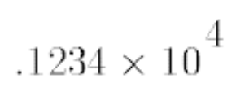
Floating-point (real binary)
Floating point representation is just one form of scientific notation.
  The base is the number of significant digits, including zero, that a positional numeral system uses to represent the number; in this example, the base is 10.
  The mantissa are the digits that define the number’s magnitude; in this example, the mantissa is .1234.
  The exponent indicates how many times the base is to be multiplied; in this example, the exponent is 4.

Slide 5
Floating-point (real binary)
Concepts
  The basic unit of storage is the bit (binary digit). As the term binary suggests, there are two possible values: 0 and 1. A sequence of 8 bits is called a byte.
  SAS stores numeric data using 64 bits (8 bytes). To create 64-bit output, use the BINARY64. format.
  The 8 bytes are divided among 3 different types of information: the sign, the exponent, and the mantissa.

Slide 6
Floating-point (real binary)
IEEE system (what we use in SAS)
Here's the byte layout for a 64-bit number in the IEEE system used by Windows (where S = sign; E = exponent; and M = mantissa):
1 bit for the sign, 11 bits for the exponent, and 52 bits for the mantissa.
The base of IEEE is 2, and the bias is 1023.(The bias is an offset used to allow for both negative and positive exponents with the bias representing 0)
The number of exponent bits determines the magnitude.
The number of mantissa bits determine the precision.

Slide 7
Floating-point (real binary)
A Example
data f_point;
x=255.75;
put x=binary64.;
run;
x=01000000 01101111 11111000 00000000 00000000 00000000 00000000 00000000
(See the paper Numeric Precision 101 )

Slide 8
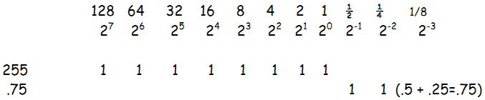
Floating-point (real binary)
A Example
Convert 255.75 to binary, base on 2, we get 11111111.11
normalizing the value: 11111111.11 = 1.111111111*10**7
For exponent 7, add bias(1023), Convert 1030 to binary, we get 10000000110
For mantissa 1.111111111, throw away the first digit and decimal point (called implied 1 bit) , Break up into nibbles (half bytes) , we get 1111 11111.
x=01000000 01101111 11111000 00000000 00000000 00000000 00000000 00000000
(See the paper Numeric Precision 101 )

Slide 9



Precision problems: Integer
Problem: LENGTH statement
data int1;
length a b c 3;
a=8191;
b=8192;
c=8193;
run;
data int2;
length x 3;
x=81933;
y=81933;
run;
When the variable is numeric, the length applies only to the output data set.

Slide 10
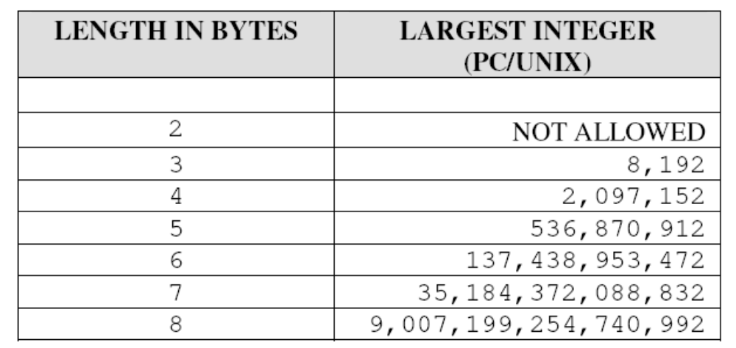
Precision problems: Integer
Reason
The 64-bit representation of 8,191:
01000000 10111111 11111111 00000000 00000000 00000000 00000000 00000000
The 64-bit representation of 8,192:
01000000 11000000 00000000 00000000 00000000 00000000 00000000 00000000
The 64-bit representation of 8,193:
01000000 11000000 00000000 10000000 00000000 00000000 00000000 00000000

Slide 11

Precision problems : Integer
Solution
  The only reason to use LENGTH statement is to save disk space, and strictly follow the table below:
  Try to use the COMPRESS=BINARY option instead of LENGTH
  (See the paper Numeric Length: Concepts and Consequences)

Slide 12

Precision problems : Fraction
Problem:
data fra_p;
a=0.1;
b=a*3;
if b=0.3 then put "EQUAL";
else do;
diff=b-0.3;
put "UNEQUAL";
put diff=;
end;
run;
UNEQUAL
diff=5.551115E-17

Slide 13
Precision problems : Fraction
Reason
  In the decimal number system, the fraction 1/3 cannot be precisely represented, it’s 0.333… When add 1/3 three times, it’s 0.99999. . . rather than exactly 1.
  Likewise, many fractions (for example, 0.1) cannot be exactly represented in SAS
data fra_r;
a=0.1;
put a=binary64.;
run;
fra=0011111110111001100110011001100110011001100110011001100110011010

Slide 14

Precision problems : Fraction
Solution
ROUND(numeric-value <, round-off-unit>)
Please note that the variable should be rounded to at least two decimal points more (x+2) than the comparison constant.
data fra_s;
a=0.1;
b=a*3;
if round(b,0.0001)=0.3 then put "EQUAL";
else do;
diff=b-0.3;
put "UNEQUAL";
put diff=;
end;
run;
EQUAL
Attention at the round-off-unit
if a=0.0985, round(b,0.01)?

Slide 15


Other considerations
Exception
data ex1;
length a 3;
a=16384;
b=16384;
run;
data ex2;
a=0.25;
b=a*10;
if b=2.5 then put "EQUAL";
else do;
diff=b-2.5;
put "UNEQUAL";
put diff=;
end;
run;
EQUAL

Slide 16


Other considerations
Formula transmutation
data gmt;
test1=40;test2=80;test3=160;test4=320;
run;
data gmt1(drop=test:);
set gmt;
baseline=10**mean(log10(test1),log10(test2));
result=10**mean(log10(test3),log10(test4));
fold=result/baseline;
diff=fold-4;
fourfold=(fold>=4);
run;
data gmt2(drop=test:);
set gmt;
baseline=(test1*test2)**(1/2);
result=(test3*test4)**(1/2);
fold=result/baseline;
diff=fold-4;
fourfold=(fold>=4);
run;

Slide 17
Other considerations
TRUNC(numeric-value, length)
data ex_trunc;
length x 3;
x=1/5;
run;
data ex_trunc2;
set ex_trunc;
if x ne 1/5 then
put 'x ne 1/5';
if x eq trunc(1/5,3) then
put 'x eq trunc(1/5,3)';
run;
To allow you to make comparisons between numerical constants and SAS numerical values stored in fewer than 8 bytes. This is necessary only for non-integer values.
When you check the value of numerical variables stored in fewer than 8 bytes, use the TRUNC function to create a numerical constant with the same number of bytes as the stored value.

Slide 18

Conclusions
Precision areas
  As for integer field
    LENGTH statement: (3 ≈ 8 thousand, 4 ≈ 2 million …)
  As for fraction field
    Storing less than 8 bytes: (would better not do so)
    Inexact accumulation and Comparing calculated values to constant: (use ROUND function)
Tips
  Avoid of using formula transmutation
  When use ROUND, define the unit properly, a smaller one is preferred; do not use ROUND too early, at the last step please.

Slide 19
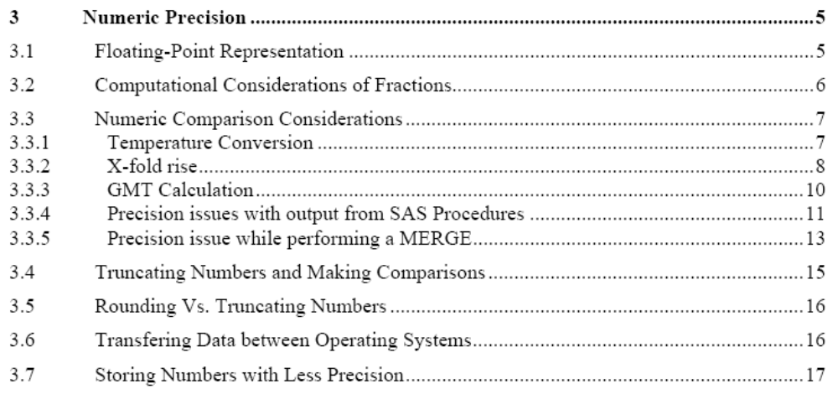
The cases in SAS Programming Tips(V2.2)
Chapter 3: Numeric Precision
SAS Programming Tips(V2.2)

Slide 20

Thank you so much!
Questions ?

